Slide 1

Data Mining for Business Analytics Concepts, Techniques, and Applications with R
Dr. Roni Ramon Gonen

Slide 2
Class Overview
Introduction to statistical methods
Learn by examples
Learn by self experience
Assignments:
4 short assignments × 10%
Individuals/ pairs
Final exam: 40%

Slide 3
Textbook
Available at the library

Slide 4
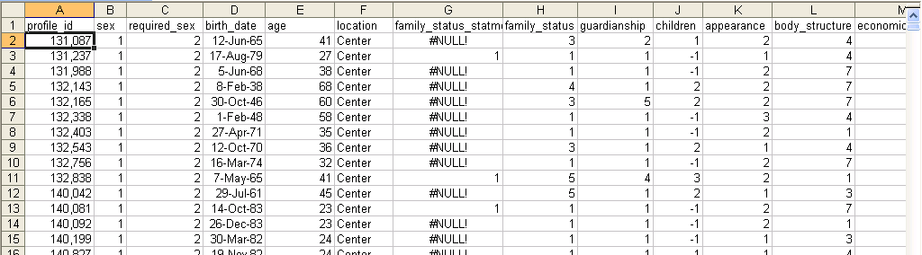
Course Plan: Part I
Intro to R
Working with datasets
Example: dating website

Slide 5
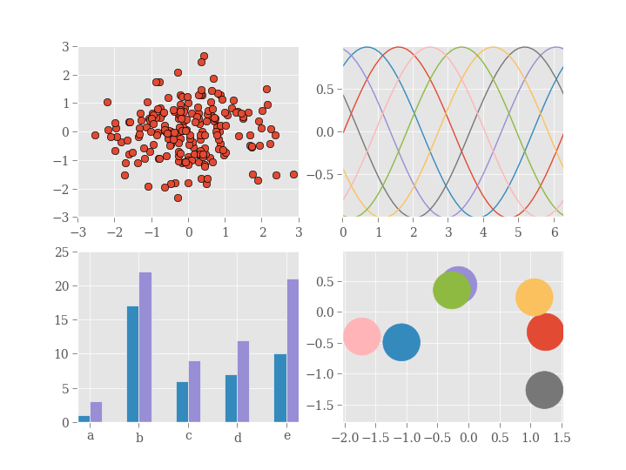
Course Plan: Part II
Data visualization
Basic
With ggplot2

Slide 6
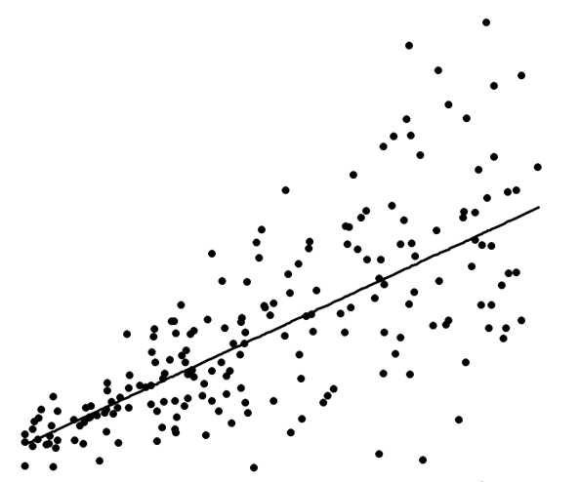
Course Plan: Part III
Regressions
Ordinary Least Squared
Stepwise regressions
Log-log models
Time series

Slide 7
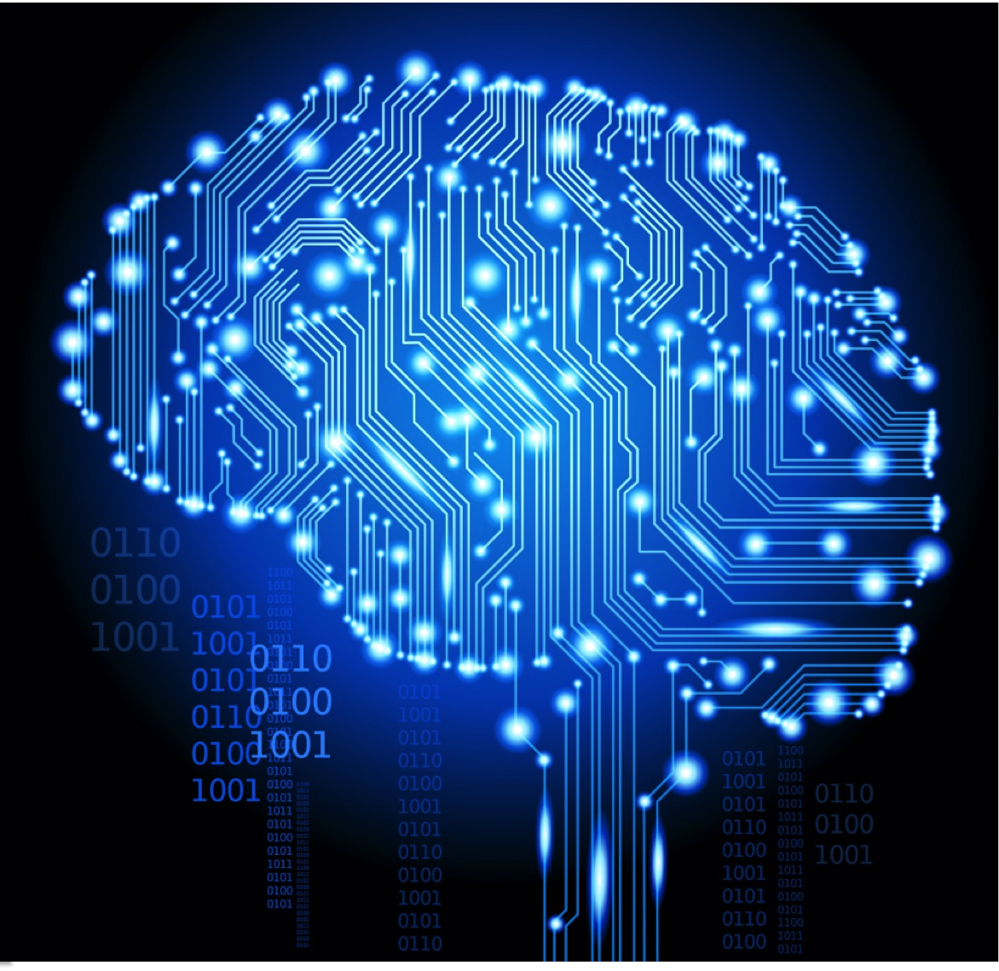
Course Plan: Part IV
Classification models
Trees & Random forests
Deep learning

Slide 8
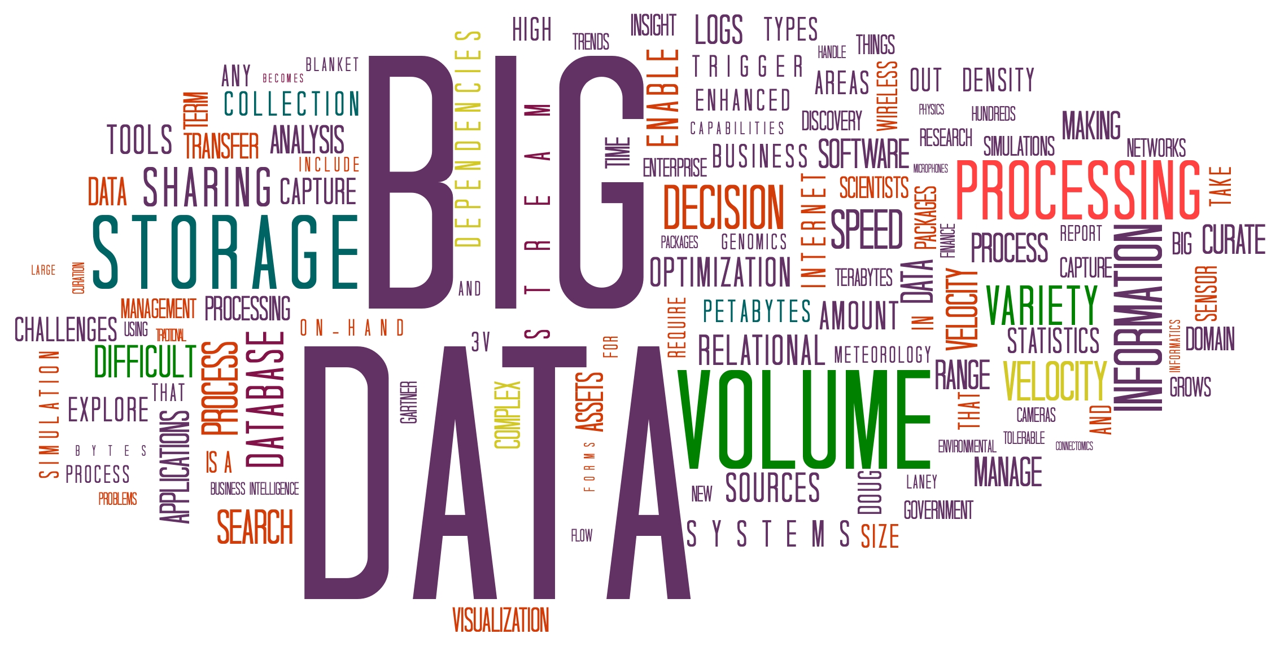
Course Plan: Part V
Big Data
Parallel R
Microsoft Azure + R

Slide 9
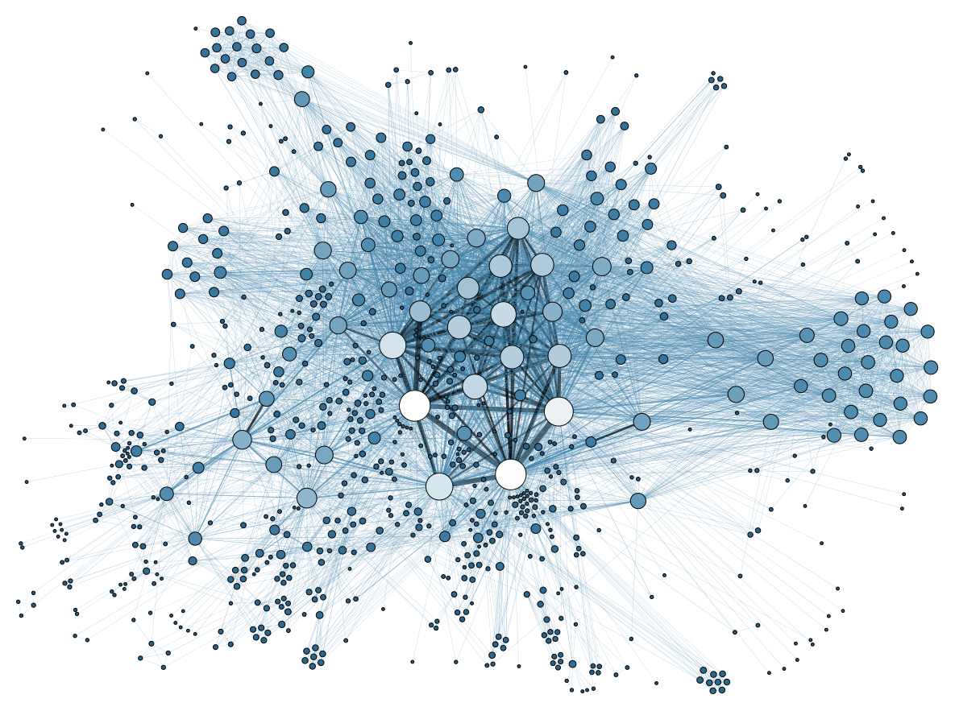
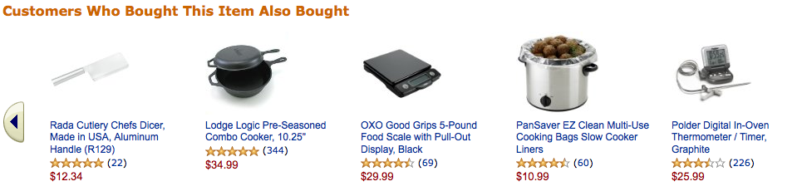
Course Plan: Extension A
Intro to collaborative-based recommendation systems

Slide 10
Software
R: https://cran.r-project.org/bin/windows/base/
R-studio: https://www.rstudio.com/products/rstudio/download/

